Slide 1

BigDataBenchMarks
Kranthi Kiran Reddy Vanga(16274077)
Bhavaz Akula(16282638)

Slide 2

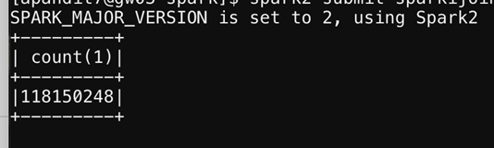
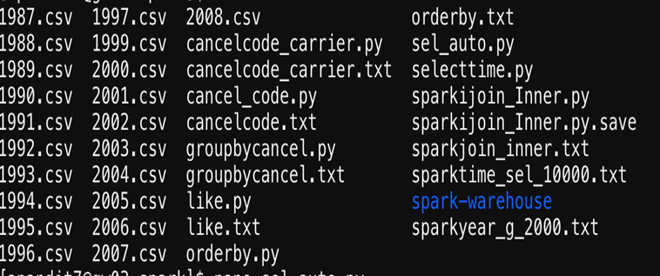
Data analyzed:
We have used the data set "Data expo 09" which consist of flight data from year 1987 to year 2019 having the details of year, month, airtime, etc.
We have worked on the data set which consists of 120 millions of records.
Data engineering has been on this data and anomalies have been removed and the final data we used for Data analysis is around 34GB.

Slide 3
Accomplishment:
Hadoop environment has been setup in ITversity Lab ,which provides big data cluster with 400GB ram.
Data has been analysed and pushed into Hadoop cluster on which Hive on Tez, Hive on Map Reduce and SparkSQL are setup and performance evaluation has been on the Flight dataset.
We executed the queries hundreds of time so that we can get accurate result.

Slide 4
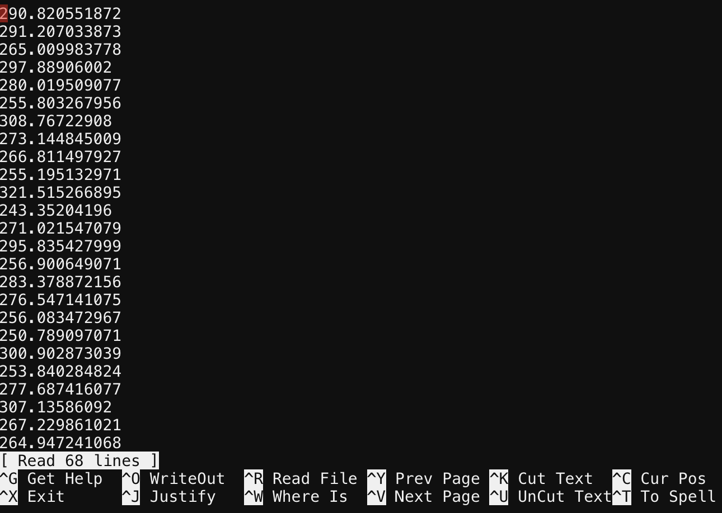

Slide 5
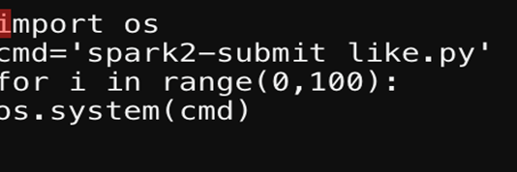
Accomplishment:
Shell script to run the query:
The queries which we executed to determine the performance of different bigdata frameworks are count , group by, order by, etc
We have taken all the Run times and took the average and compared with other tools.
Data has been visualized using Plotly-Dash which is data analytics and visualization tool
Our python server is running on heroku app
Link : kkrv.herokuapp.com

Slide 6
Technologies:
ITversity
Big Data frameworks (Hive on Tez, Hive on MapReduce, SparkSql)
Plotly-Dash
Heroku

Slide 7
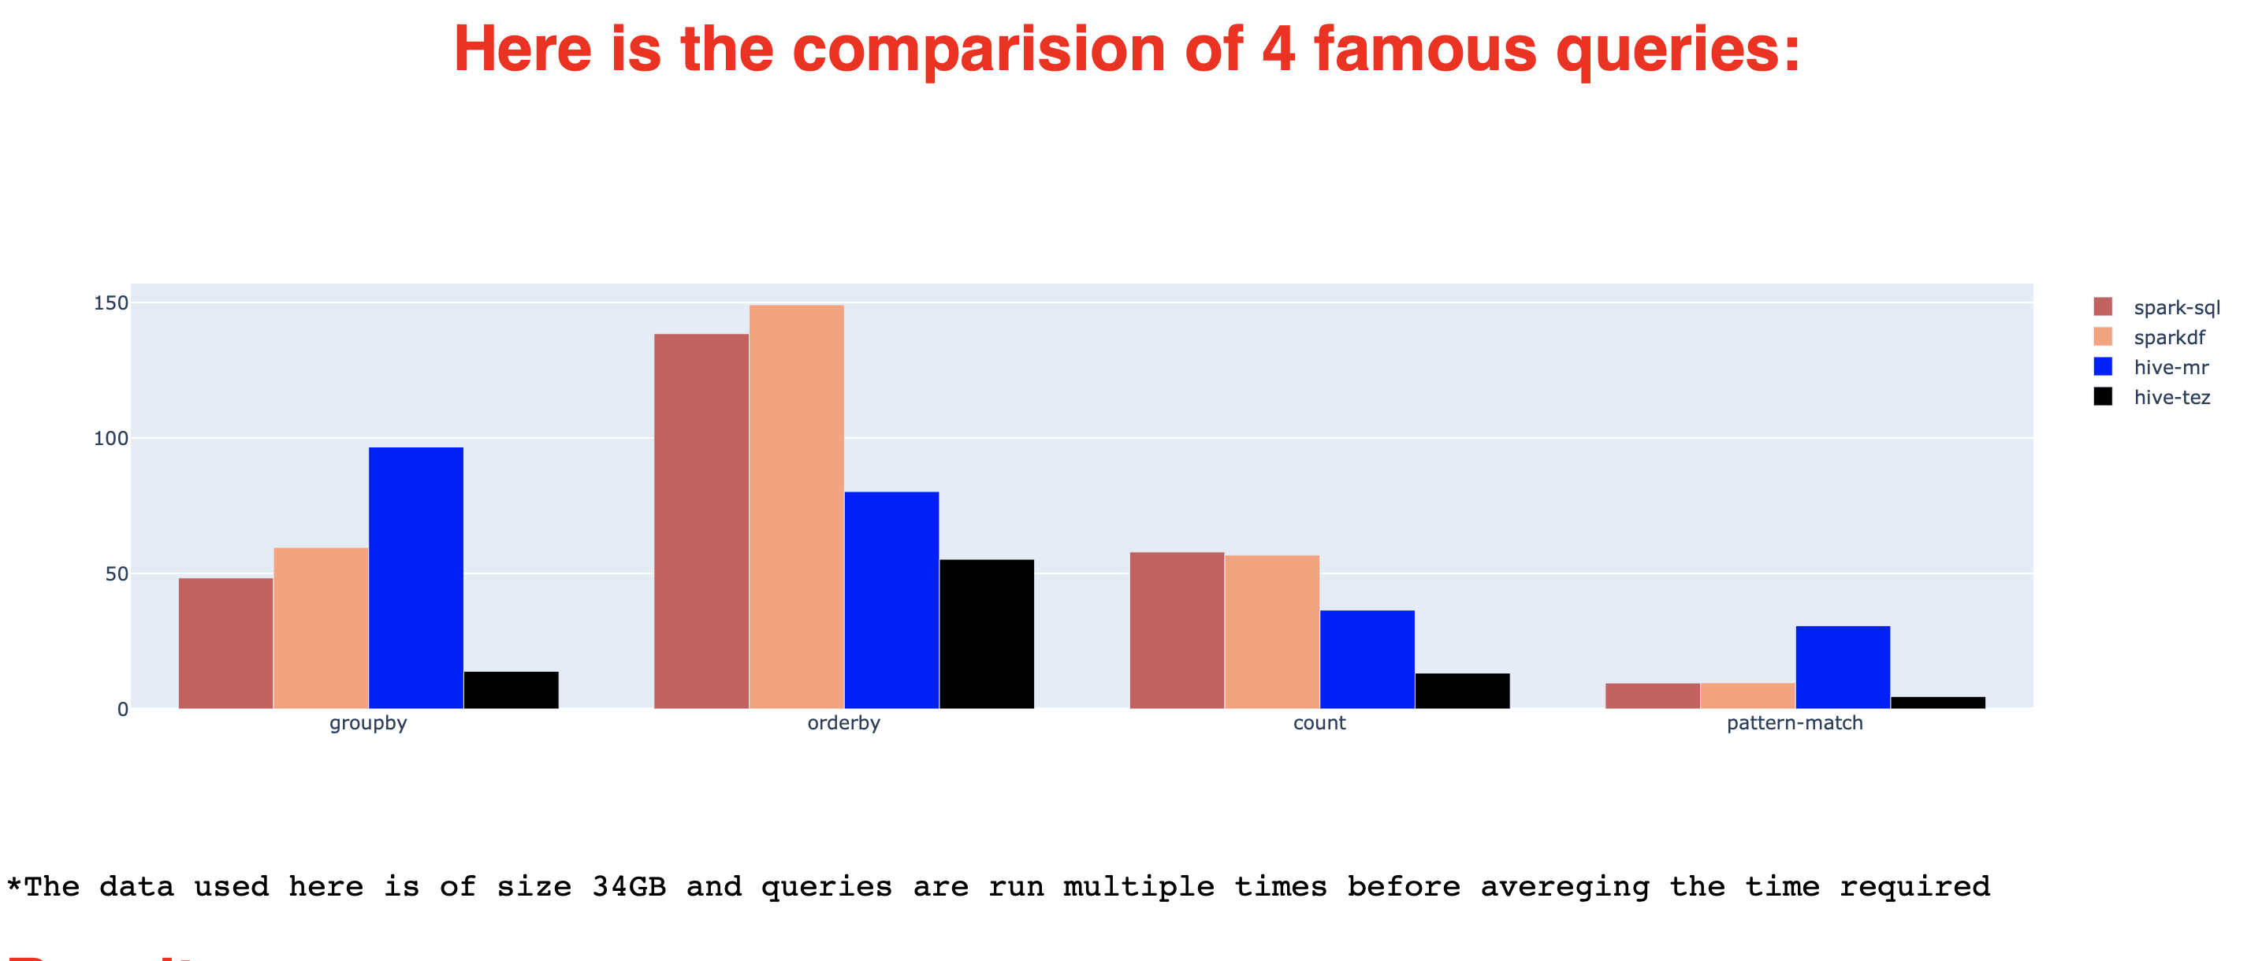
Outcomes:

Slide 8
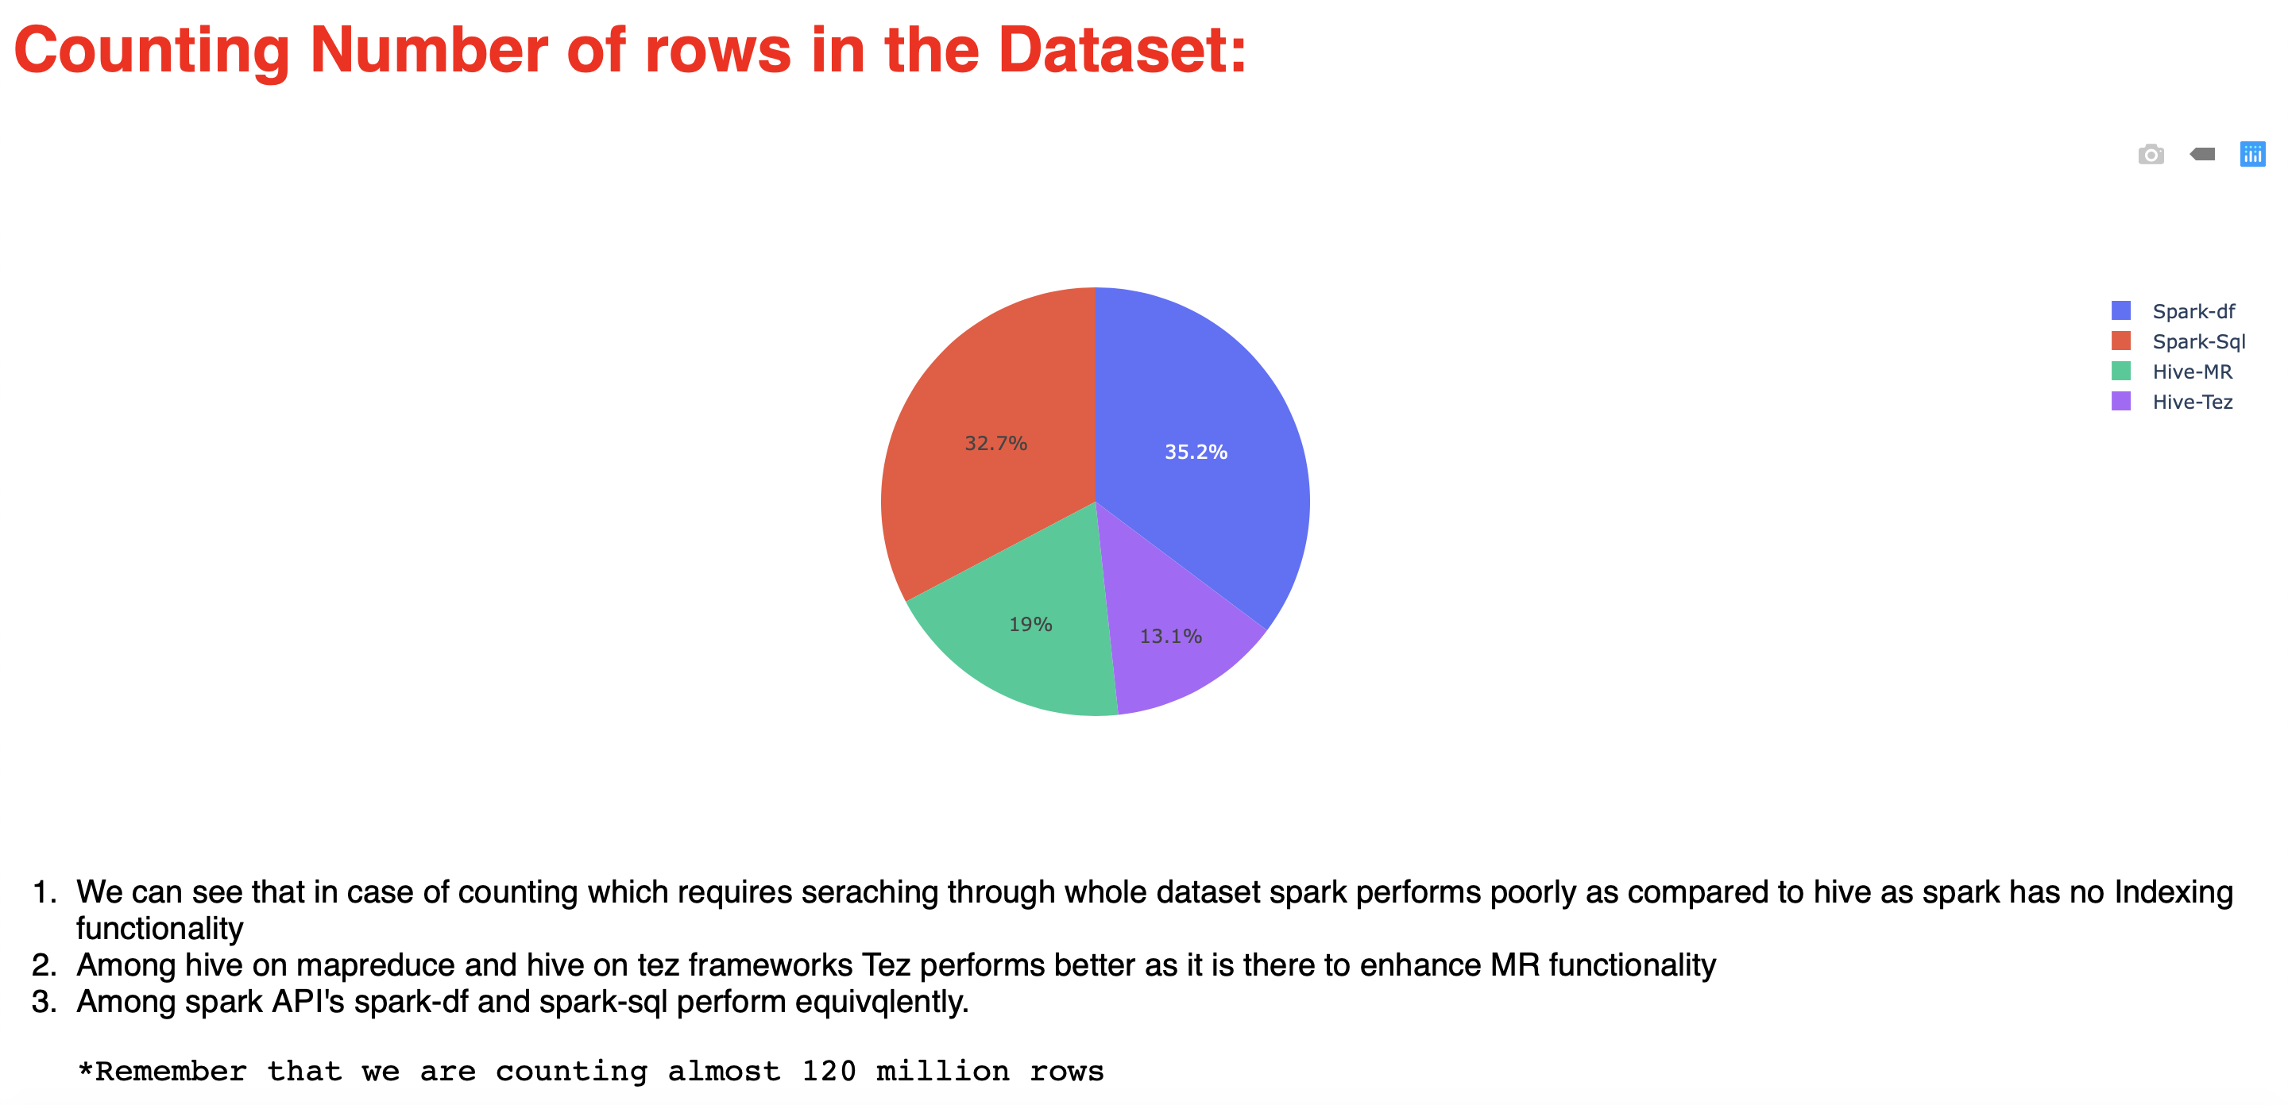
Outcomes:

Slide 9
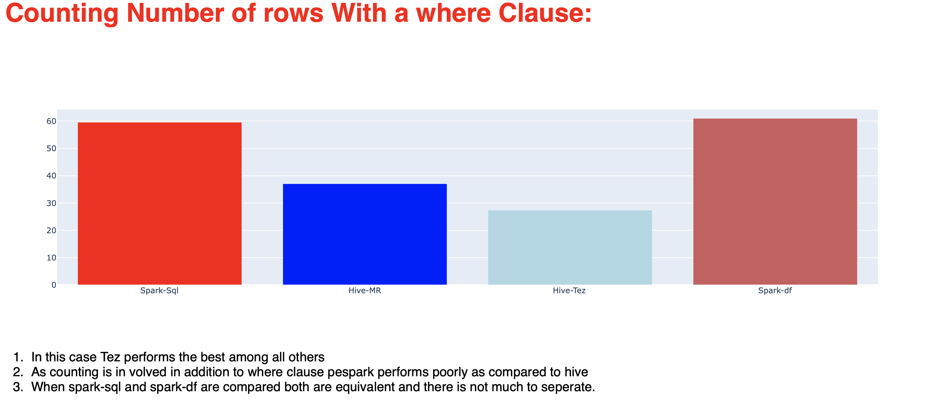
Outcomes:

Slide 10
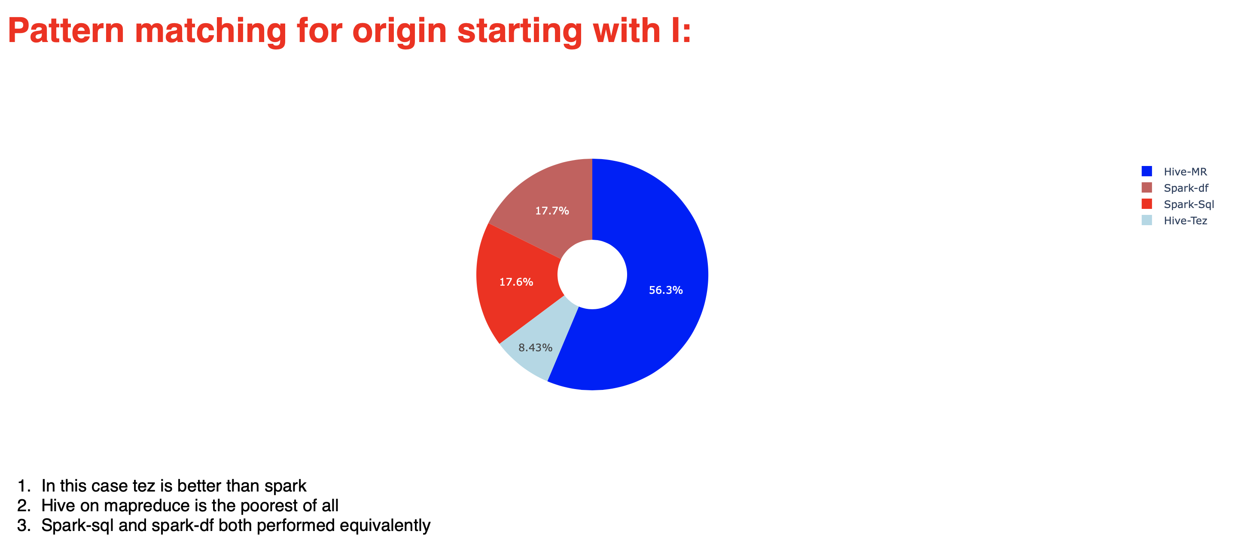
Outcomes:

Slide 11
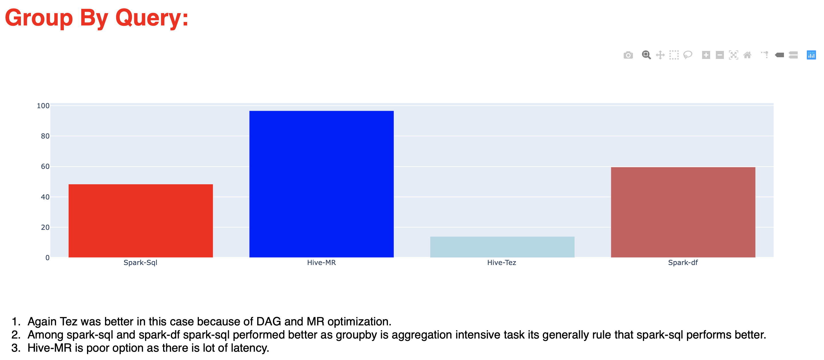
Outcomes:

Slide 12
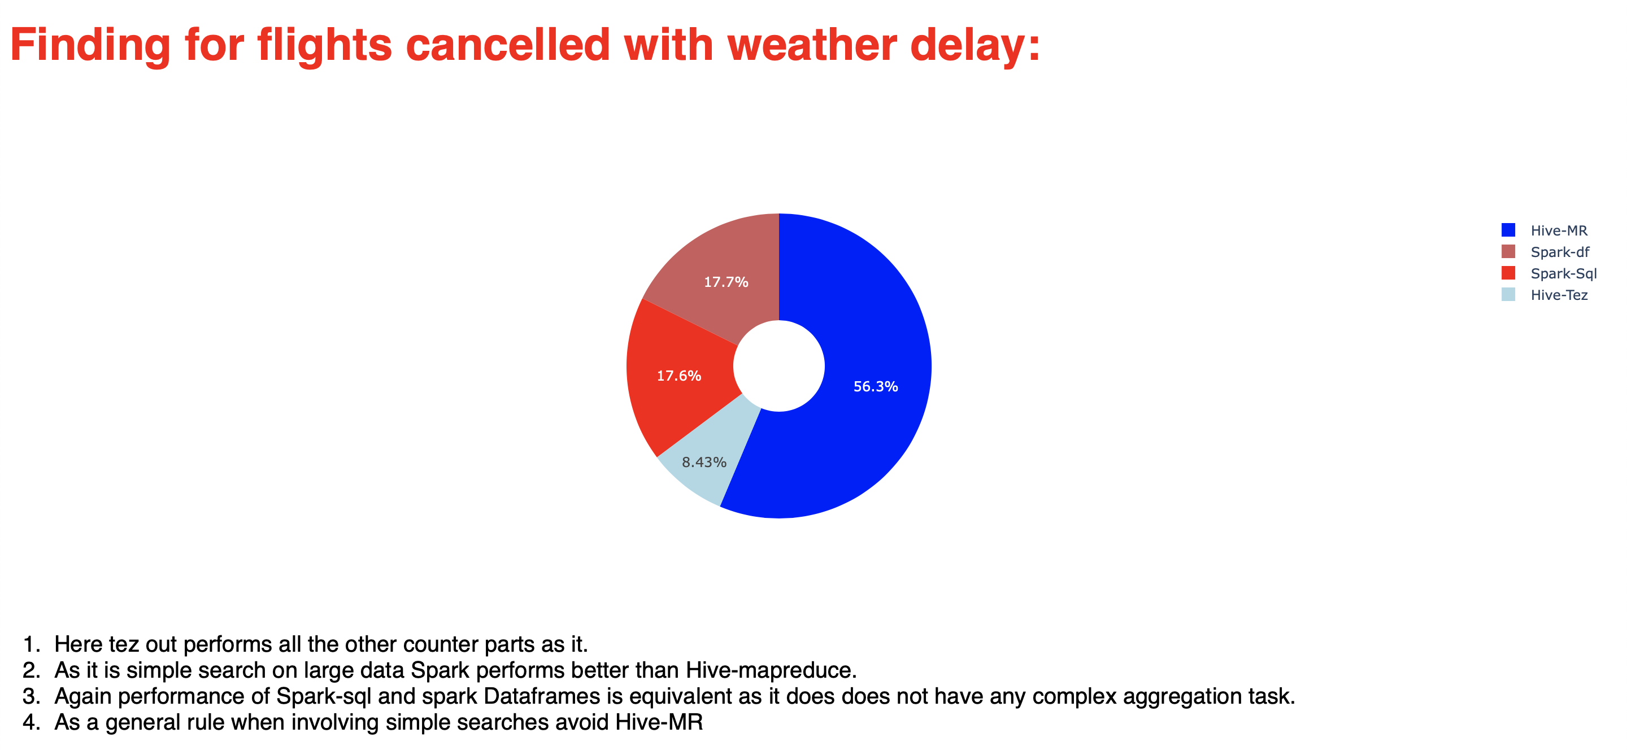
Outcomes:

Slide 13
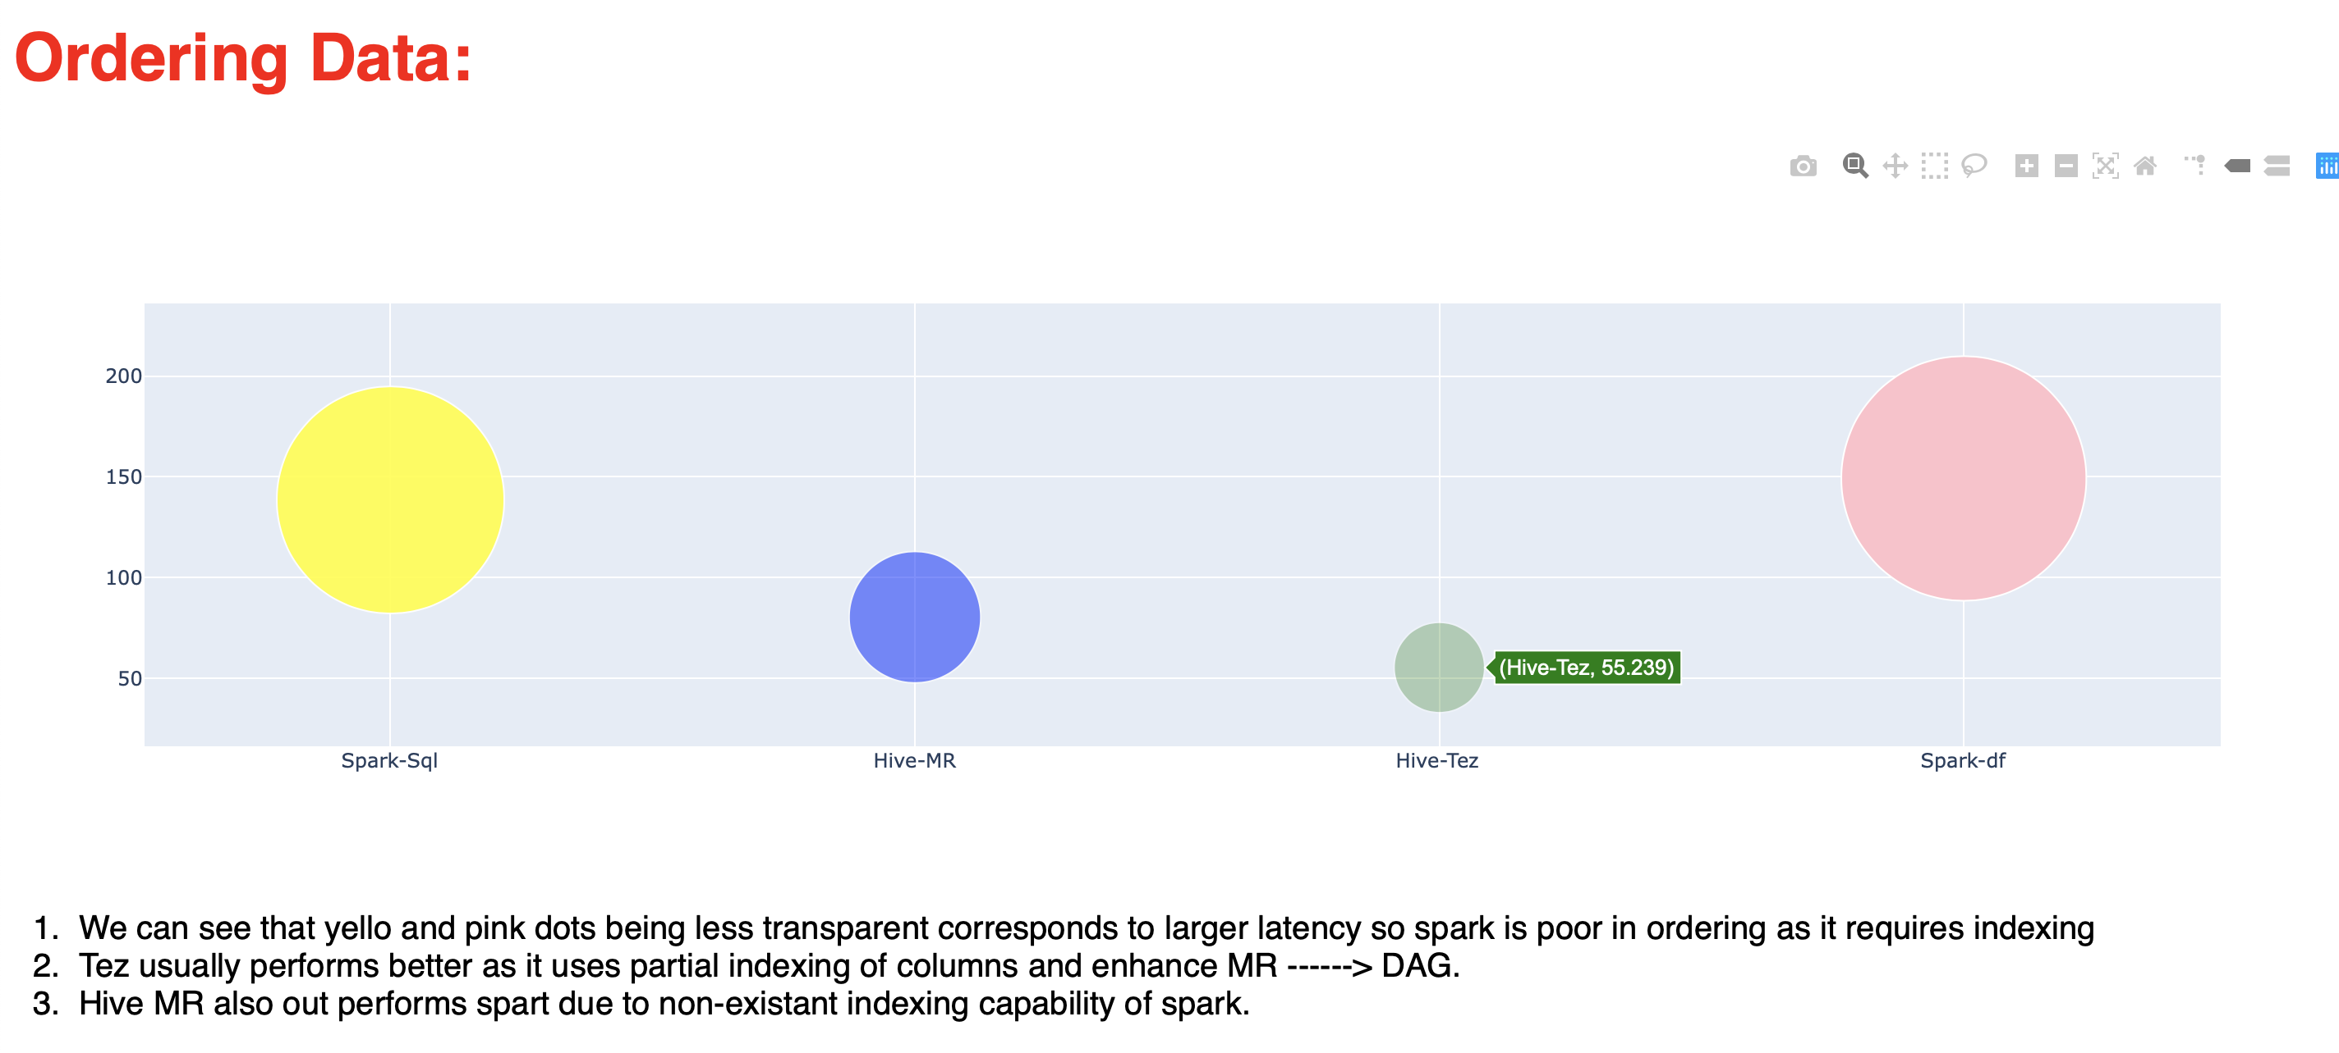
Outcomes:

Slide 14
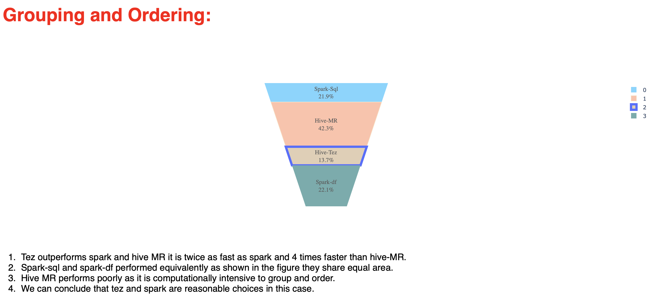
Outcomes:

Slide 15
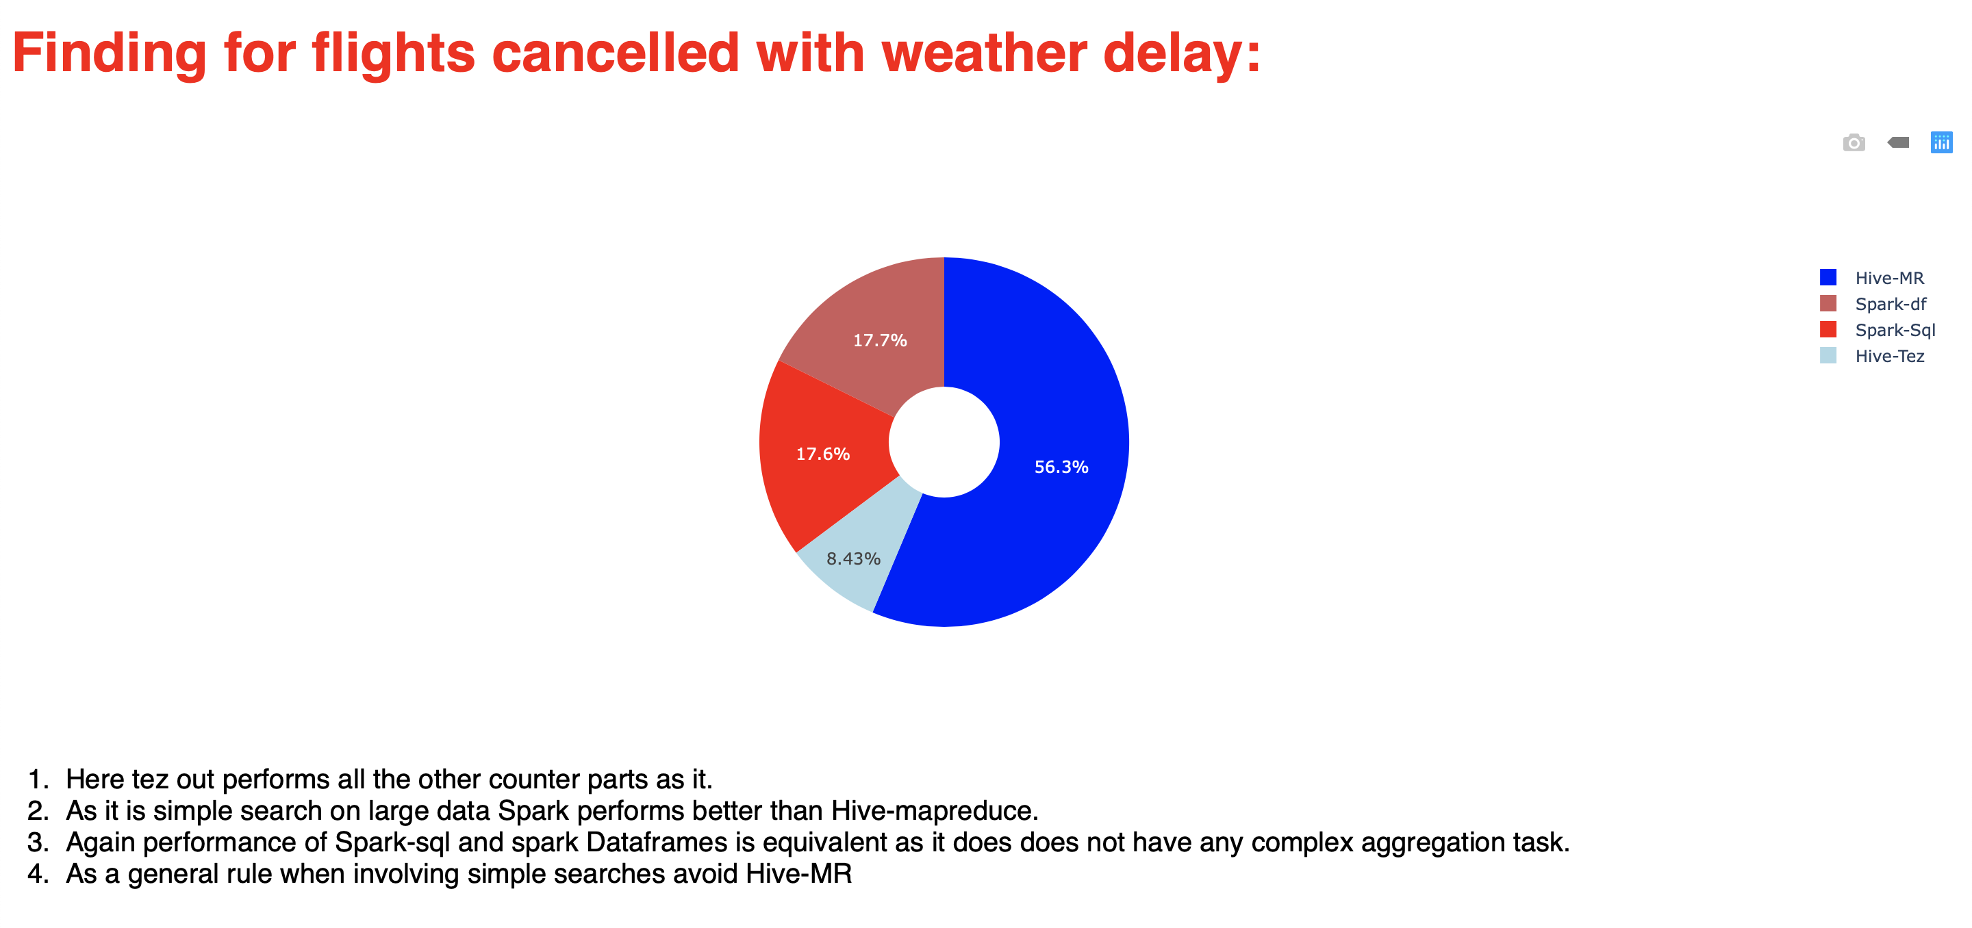
Outcomes:

Slide 16
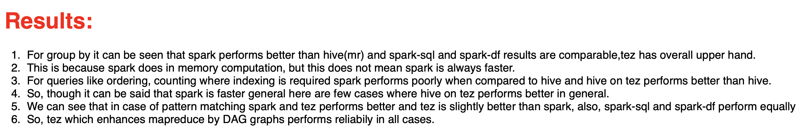

Slide 17
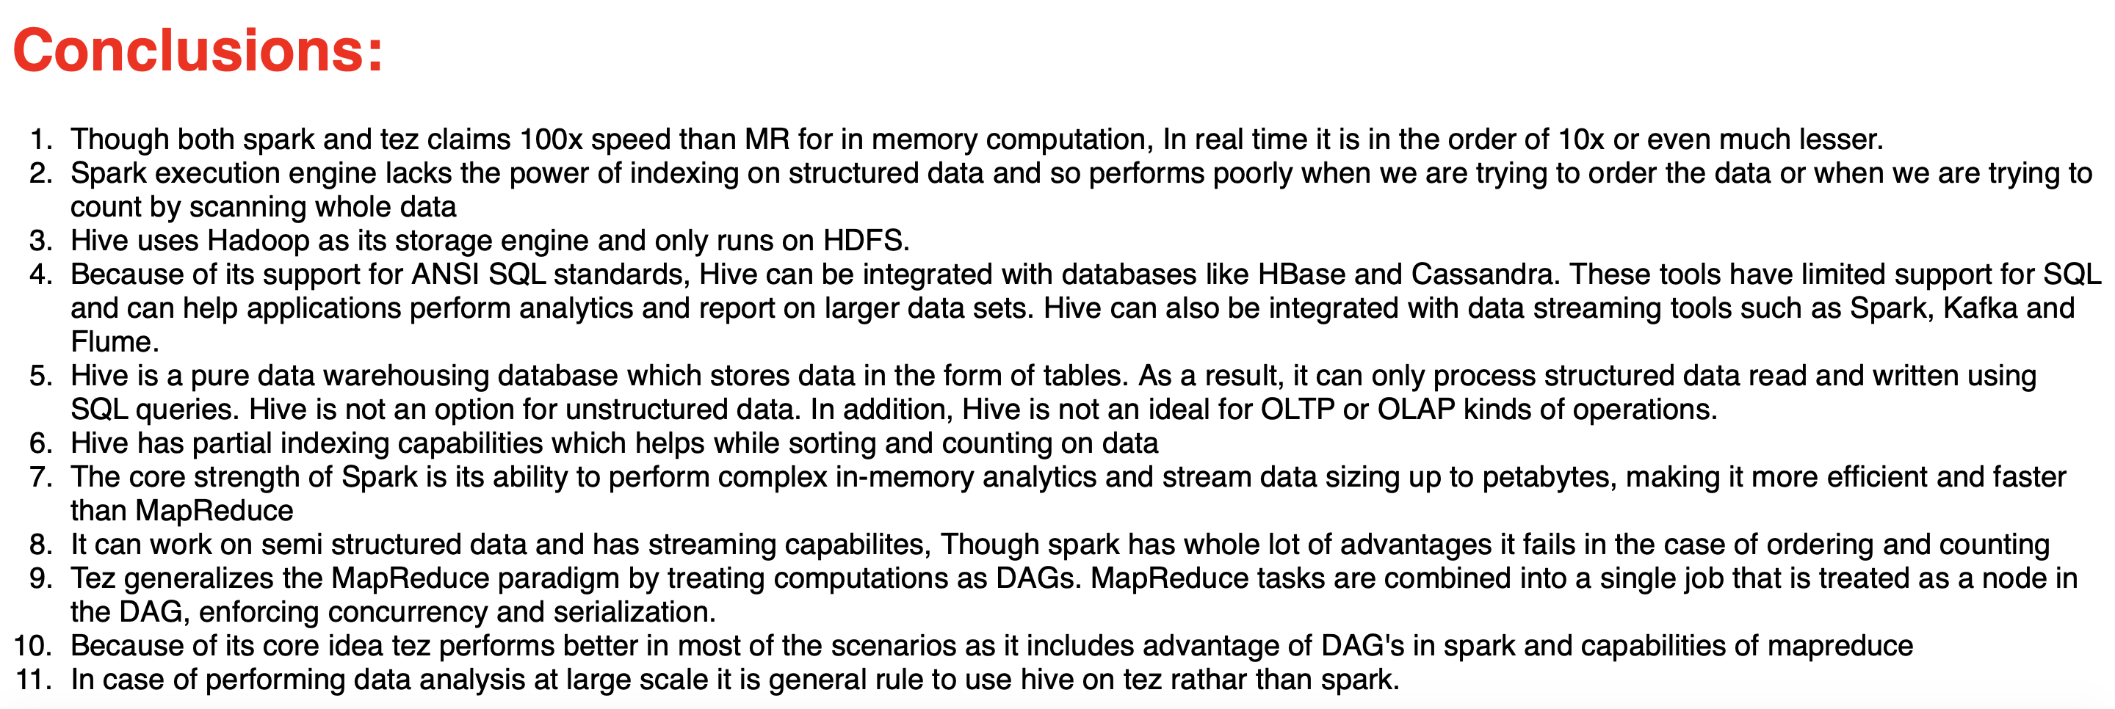

Slide 18
Issues Faced:
GC overhead error for running out of memory.
This error was due to the cartesian product nature of join operation which unfortunately could not be overcome so we scaled the data down for join operation.
Query Times for join is more than 300 seconds with data scaled down to 1000 times
- As part of our project objective we had to run each query
100 times
Data engineering at such large scale was notoriously time taking.

Slide 19
Learning Outcomes
Data Analysis
Storing and deploying on Cloud
New application development architecture
Learning plotly and dash
Learning Big Data frameworks.

Slide 20
Thank you!

